Slide 1


መቀነት (Mekenet)
GROUP 5

Slide 2
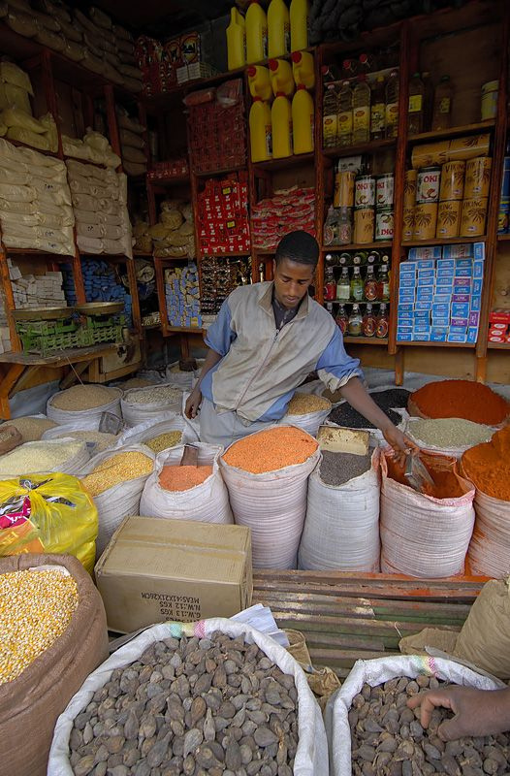

INTRODUCTION
INTRODUCTION
መቀነት (Mekenet)
is an offline-first financial record application designed for small businesses in Addis Ababa. It automatically converts Telebirr payment SMS messages into organized transaction records, helping business owners easily track their income, expenses, profit, and customer debts. The application is designed to work primarily on the device, keeping financial information private and secure while allowing users to export their records when they choose.
መቀነት (Mekenet)
is an offline-first financial record application designed for small businesses in Addis Ababa. It automatically converts Telebirr payment SMS messages into organized transaction records, helping business owners easily track their income, expenses, profit, and customer debts. The application is designed to work primarily on the device, keeping financial information private and secure while allowing users to export their records when they choose.
01
01

Slide 3

Statement of the Problem
Statement of the Problem
Small business owners often receive payments through Telebirr, cash, and other methods, but keeping accurate financial records can be difficult. Manual bookkeeping takes time and may lead to missing transactions, making it harder to know their actual income, expenses, profit, and outstanding debts. Poor financial records can also make it difficult for businesses to make good decisions or prepare records when applying for loans.
Small business owners often receive payments through Telebirr, cash, and other methods, but keeping accurate financial records can be difficult. Manual bookkeeping takes time and may lead to missing transactions, making it harder to know their actual income, expenses, profit, and outstanding debts. Poor financial records can also make it difficult for businesses to make good decisions or prepare records when applying for loans.
02
02

Slide 4


OBJECTIVES
Objectives / Solutions
Automate transaction recording from Telebirr SMS.
Track income, expenses, profit, and customer debts.
Reduce manual bookkeeping and recording errors.
Provide simple daily, weekly, and monthly financial insights.
Work offline without depending on an internet connection.
Protect financial data through encrypted local storage.
Allow users to manually record cash expenses.
Enable user-controlled export of financial records.
03

Slide 5

our visions
Make money management simple, accessible, and convenient.
Automatically organize mobile-money transactions into clear records.
Help users track income, expenses, and daily cash flow.
Provide clear financial insights from everyday transactions.
Help users monitor debts and money owed.
Support better budgeting and financial decision-making.
Reduce the need for manual financial record keeping.
Work effectively offline with secure local data storage.
Protect users' financial information through strong privacy and security.
Support small businesses in managing daily financial activities.
Build a foundation for smarter digital financial management in Ethiopia.
Improve users' financial awareness and accountability.
04

Slide 6

Key Features
Automatic SMS Parsing – Converts Telebirr payment SMS into transactions.
Income & Expense Tracking – Automatically records received and sent payments.
Self-Learning Matcher – Learns from confirmed item matches for faster future transactions.
Profit Dashboard – Shows daily, weekly, and monthly financial summaries.
Manual Expense Entry – Allows users to quickly record cash expenses.
Debt Tracking – Keeps a simple list of customers who owe money.
Offline-First – Core features work without an internet connection.
Secure Storage – Protects financial data using encrypted local storage.
User-Controlled Export – Allows users to export or sync their records when needed.
04

Slide 7

Actors
MEKENET APPLICATION
BACKEND API
BANK / MICROFINANCE INSTITUTION
BUSINESS OWNER
SMS SERVICE
The main user of Mekenet who manages daily transactions, checks financial summaries, records expenses, and tracks customers who owe money.
Provides Telebirr payment notifications to the application. Mekenet processes these messages automatically to identify transaction details.
The core system that receives and parses SMS messages, records transactions, calculates financial information, and presents it to the business owner.
Handles optional synchronization and generates reports when the user chooses to export their financial records.
A potential external actor that can use the exported financial report when evaluating a business for loans or other financial services.
05

Slide 8

LIMITATIONS
The current MVP is designed specifically for Android devices.
The application currently supports Telebirr SMS, while CBE Birr integration is planned for future development.
Changes in Telebirr SMS formats may affect the accuracy of automatic transaction parsing.
Cash transactions cannot be detected automatically and need to be entered manually.
Customer debts must be added and updated manually by the user.
Detailed inventory tracking and stock alerts are not included in the current MVP.
Financial forecasting and AI-based advice are planned for future versions.
Data is stored locally by default, and synchronization only happens when the user chooses.
06

Slide 9


methodology
The project follows an Agile and iterative development approach.
The system is developed using a modular and offline-first architecture.
Development is divided among team members based on specific responsibilities.
The SMS parser is developed as a pure, testable function.
Features are tested continuously through unit, widget, and integration testing.
The core flow is validated on a real Android device.
Real, anonymized Telebirr SMS samples are used to evaluate parser accuracy.
The complete flow is tested from SMS → Parser → Transaction → SQLite → Financial Summary.
The final stage includes accuracy measurement, bug fixing, and demo evaluation.
07
07

Slide 10
functional requirements
The system shall receive incoming Telebirr SMS messages.
The system shall extract transaction details such as amount, direction, and counterparty.
The system shall automatically record income and expenses from SMS transactions.
The system shall store transactions securely in the local database.
The system shall prevent duplicate transaction records.
The system shall match transaction amounts with registered items.
The system shall learn from user-confirmed or corrected matches.
The system shall allow users to manually add cash expenses.
The system shall allow users to add and manage customer debts.
The system shall display daily, weekly, and monthly financial summaries.
The system shall allow users to export or synchronize their records when requested.
08

Slide 11

non-functional requirements
The application must protect financial data using encrypted local storage.
The application must keep raw SMS content private and must not transmit it.
The core features must work without an internet connection.
The application should run efficiently on low-end Android devices.
The system should process transactions quickly and update the financial view without unnecessary delays.
The application must handle unrecognized SMS formats gracefully without crashing.
The parser should achieve a target accuracy of at least 90%.
Data synchronization must occur only when explicitly requested by the user.
09

Slide 12
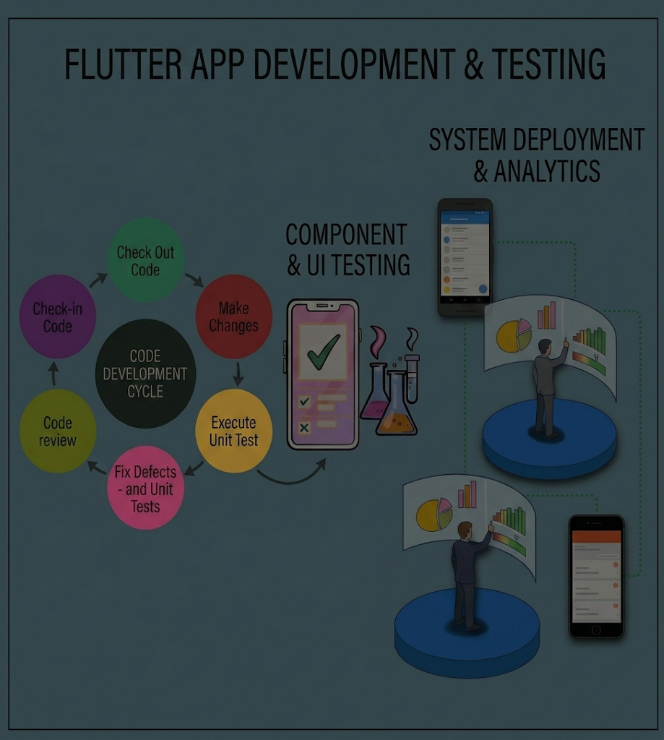
testing and evaluation
Unit testing is used to test individual components such as the parser and matcher.
Widget testing is used to verify the application's user interface.
Integration testing checks the complete system workflow.
Real Android devices are used to test SMS processing and application behavior.
The system is tested through the complete flow: SMS → Parser → Transaction → SQLite → Financial Summary.
Testing also identifies unsupported SMS formats and potential system failures.
10

Slide 13

future enhancment
Support CBE Birr and other mobile-money payment platforms.
Add inventory management with stock tracking and alerts.
Introduce financial forecasting to help businesses plan ahead.
Add AI-powered financial insights and recommendations.
Improve bank-ready reports and export features for loan applications.
Add voice input to make recording expenses faster and easier.
Expand the application to support more types of small businesses.
11

Slide 14
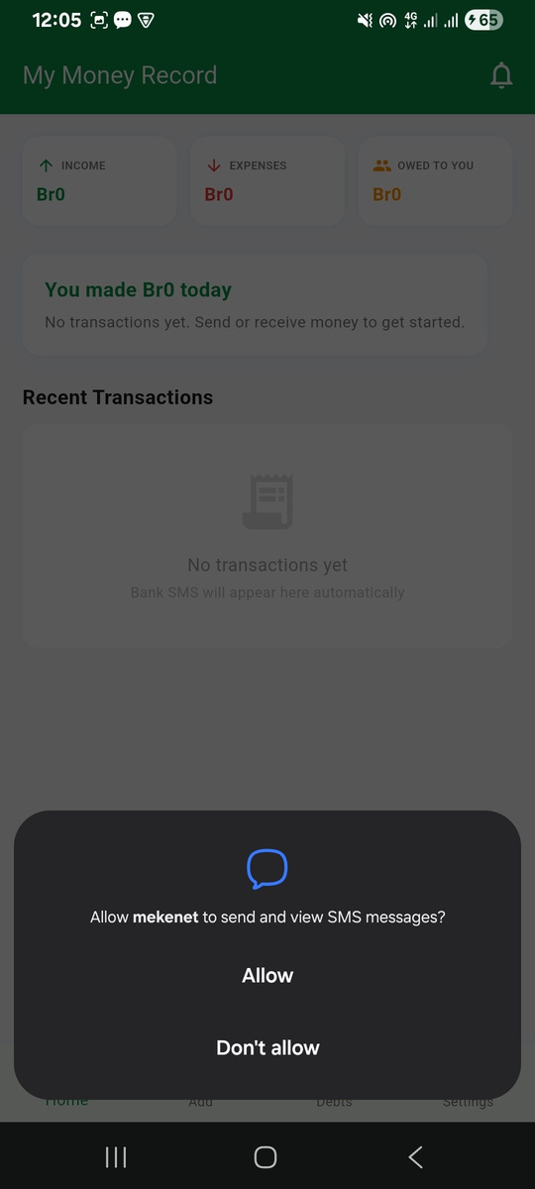
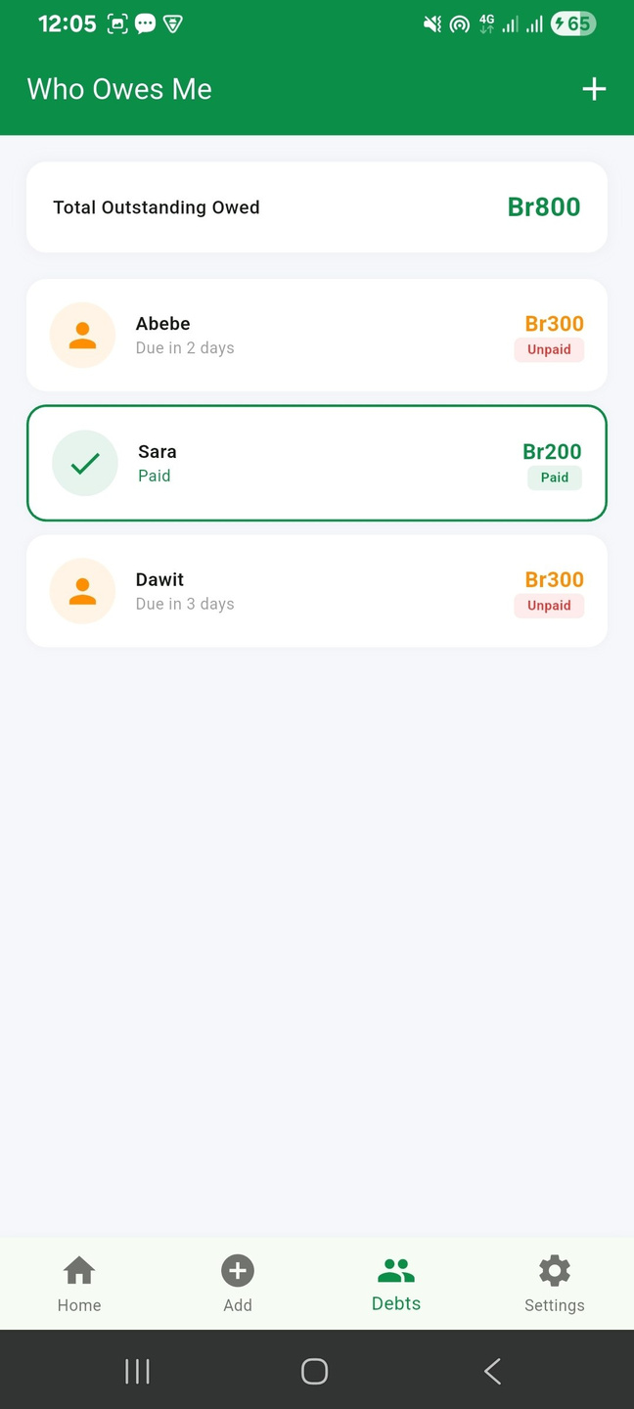
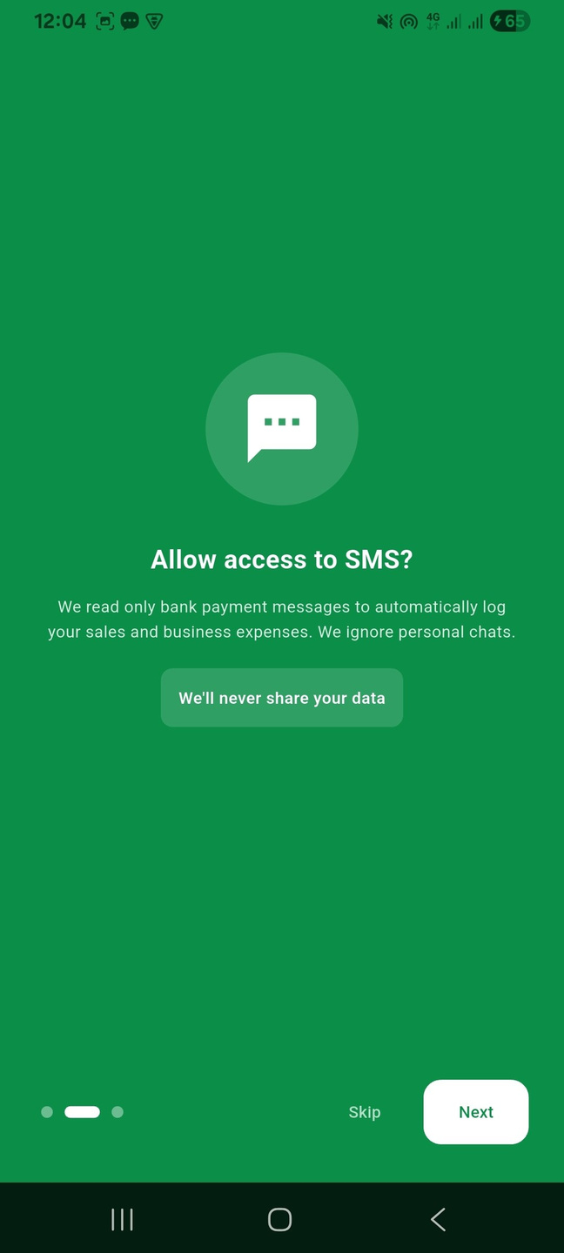
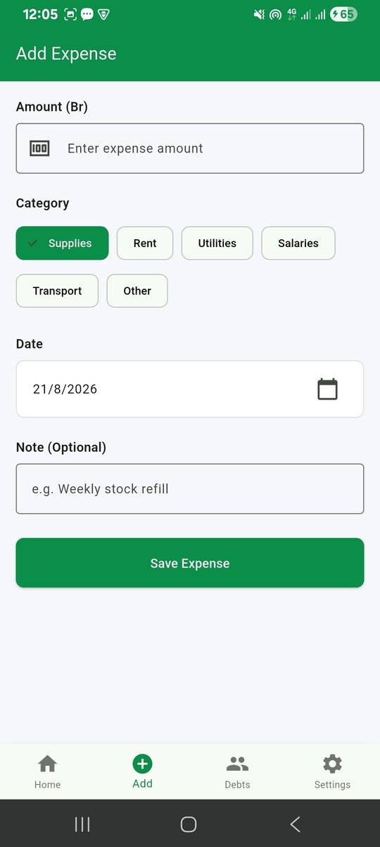
UI OF OUR APPLICATION
12

Slide 15
conclusion
Mekenet provides a practical solution for improving financial record management for small businesses. It reduces the effort of daily bookkeeping by organizing transactions in a simple way. The application is designed to remain useful even without an internet connection. It also focuses on keeping business information secure and under the user's control. The system demonstrates how mobile technology can solve real financial management challenges. Its modular design makes it easier to improve and expand in the future. With additional features and wider payment support, Mekenet can serve more types of businesses. Overall, the project provides a strong foundation for smarter and more organized small-business financial management.
13

Slide 16





MEET OUR
team members
LEWI KIBRU
LOMBAMME LEMMA
HELEN TESFAYE
KENAWAK BERHANU
MEKDES TESFAYE
CTC-6064-26
CTC-888-26
CTC-1586-26
CTC-6591-26
CTC-1711-26
leader
Backend API & Database Developer
SMS Integration & Local Storage Developer
Transaction Parsing & Matching Developer
Backend API & Data Services Developer
Frontend UI
Developer
14

Slide 17

Thank You
2026

